Slide 1
Topic - Work
MPU33213
Computer Ethics and Professional Responsibility

Slide 2
Topics covered
Impact of computers on jobs
Telecommuting
Offshoring and a global workforce
Monitoring employees
Work / personal device use

Slide 3
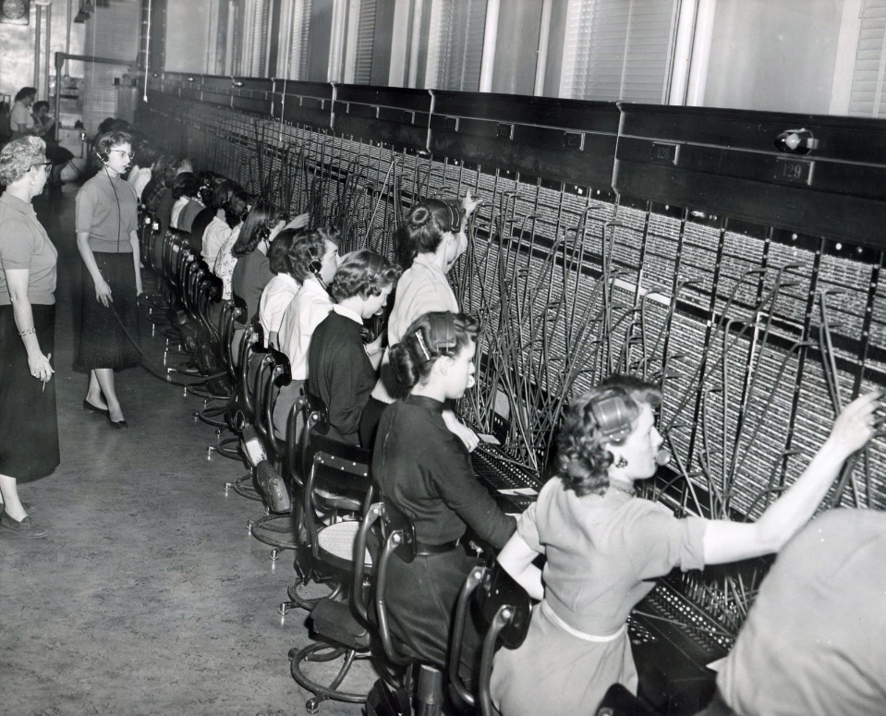
Negative impact on jobs
Eliminate many jobs because of increased efficiency and automation
ATMs vs. bank tellers
Telephone switchboard operators
Notes:
Many social critics, social scientists, politicians, unions, and activists saw virtually all potential effects of computers on work as highly threatening.
Arguments:
Acquiring computer skills was a heavy burden for workers
The need for increased skills would widen the earning gap between those who obtain the news skills and those who don’t.
Switchboard: http://wallawalladrazanphotos.blogspot.my/2011/04/pacific-telephone-building-switchboard.html

Slide 4
Negative impact on jobs
Eliminate many jobs because of increased efficiency and automation
Travel agencies & agents vs. online booking & self check-in kiosks
Typewriter-related jobs: building, selling and repairing
Printing industry vs. digital media
Notes:
Many social critics, social scientists, politicians, unions, and activists saw virtually all potential effects of computers on work as highly threatening.
Arguments:
Acquiring computer skills was a heavy burden for workers
The need for increased skills would widen the earning gap between those who obtain the news skills and those who don’t.

Slide 5

Negative impact on jobs
Eliminate many jobs because of increased efficiency and automation
Film vs. digital camera (Kodak files for bankruptcy)
Notes:
Many social critics, social scientists, politicians, unions, and activists saw virtually all potential effects of computers on work as highly threatening.
Arguments:
Acquiring computer skills was a heavy burden for workers
The need for increased skills would widen the earning gap between those who obtain the news skills and those who don’t.
Kodak film: https://www.istockphoto.com/my/photo/35mm-kodak-camera-film-gm458621755-19254580

Slide 6
Negative impact on jobs
Eliminate many jobs because of increased efficiency and automation
Notes:
Many social critics, social scientists, politicians, unions, and activists saw virtually all potential effects of computers on work as highly threatening.
Arguments:
Acquiring computer skills was a heavy burden for workers
The need for increased skills would widen the earning gap between those who obtain the news skills and those who don’t.
Buffalo: https://www.acsh.org/news/2016/08/23/mystery-meat-what-other-animals-are-in-that-hot-dog

Slide 7
Negative impact on jobs
Pace of improvement in computing technology causes disruption
Pace of improvement in speed, capability and cost for computing and communication technology is much faster than other technologies.
Constantly need to RELEARN
Notes:
Many social critics, social scientists, politicians, unions, and activists saw virtually all potential effects of computers on work as highly threatening.
Arguments:
Acquiring computer skills was a heavy burden for workers
The need for increased skills would widen the earning gap between those who obtain the news skills and those who don’t.

Slide 8
Negative impact on jobs
New jobs in computing technology creates big earning gap between two distinct groups
highly educated and non-educated
new skills obtained?
Offshoring eliminates jobs locally
hiring employees in other countries
Notes:
Many social critics, social scientists, politicians, unions, and activists saw virtually all potential effects of computers on work as highly threatening.
Arguments:
Acquiring computer skills was a heavy burden for workers
The need for increased skills would widen the earning gap between those who obtain the news skills and those who don’t.

Slide 9
Positive impact on jobs
Increase productivity
Lower product price
Lower living cost
affordable
Increase demand
Better living
standard
Require more workers

Slide 10
Positive impact on jobs
Increase efficiency
More time
Increase earning
Better living
standard
Increase demand
Require more workers /
New services / products

Slide 11
Positive impact on jobs
Creation of new products and new industries
Software engineers, system analysts, repair, and maintenance, system / consumer support, etc.
More efficient training
Companies can train quickly and using automated support systems.
Expand the market of a product

Slide 12
Telecommuting
Telecommuting refers to working for an employer at a computer-equipped space in the employee’s home or some other external location.
Individuals / small businesses can operate globally via the Web
Company can be located in small town
Notes:
Telecommuting refers to working for an employer at a computer-equipped space in the employee’s home or some other external location.
It can also include running one’s own business from home.

Slide 13
Telecommuting benefits
Reduces costs for employers
real estate and office rentals
Reduces rush-hour traffic congestion
pollution, gasoline, stress, expenses for commuting
Employee satisfaction
more productive, and more loyal to their employers.
Notes:
Telecommuting refers to working for an employer at a computer-equipped space in the employee’s home or some other external location.
It can also include running one’s own business from home.

Slide 14
Telecommuting benefits
Easier to work with people globally
Can work at home for a few hours at night, compatible with different time zones
More time to spend with family
Provides work options for elderly or disabled people
commuting is physically difficult and expensive.
Allows work to continue in bad weather conditions
Notes:
Telecommuting refers to working for an employer at a computer-equipped space in the employee’s home or some other external location.
It can also include running one’s own business from home.

Slide 15
Telecommuting problems
Resentment among employees who must work at the office
Might weaken corporate loyalty
Lack of immediate supervision (some employees need better direction)
Lower productivity or working too hard and long
Too much distraction at home
Blurring the boundary between home and work causes stress for workers
Notes:
Telecommuting refers to working for an employer at a computer-equipped space in the employee’s home or some other external location.
It can also include running one’s own business from home.

Slide 16
Telecommuting problems
Miss important things
mentoring relationships and opportunities for advancement.
Social interactions at work, significant part of pleasant working conditions for some people
Notes:
Telecommuting refers to working for an employer at a computer-equipped space in the employee’s home or some other external location.
It can also include running one’s own business from home.

Slide 17
Offshoring and outsourcing
Offshoring
Hiring employees in other countries. E.g.
Customer service call centres / help desks
Programmers
Payroll, insurance claims processing
Manufacturing moved to less wealthy countries especially in Asia
Reasons: low pay rate, professionals availability, facilities cost, rules and regulations, ability to interact in English, etc.
Notes:
Telecommuting refers to working for an employer at a computer-equipped space in the employee’s home or some other external location.
It can also include running one’s own business from home.

Slide 18
Offshoring and outsourcing
Outsourcing
company pays other companies to build parts for its products or provide services
can be in the same or different country
Notes:
Telecommuting refers to working for an employer at a computer-equipped space in the employee’s home or some other external location.
It can also include running one’s own business from home.

Slide 19
Offshoring Impact
Job loss vs. job shift
Local: job loss, decrease in salaries and standard of living
Offshoring destinations: new job opportunities
Increased demand for goods and services
lower labour costs reduce prices for consumers
increased income and reduced prices for goods and services helps grow the economies
Notes:
Telecommuting refers to working for an employer at a computer-equipped space in the employee’s home or some other external location.
It can also include running one’s own business from home.

Slide 20
Problems and side effects
Customer service:
Foreign accents difficult to understand
Service personnel not familiar with the product, just follow instructions in manuals / handbooks
Time differences - need to work night-shifts (income vs. health)
Need new job skills. E.g.
Manage people from different cultures
Schedule meeting based on foreign working hours

Slide 21
Problems and side effects
Increased demand for highly-skilled workers in offshoring destinations
forced their salaries up
eliminates original cost savings

Slide 22
Ethics of hiring developers
Issue: foreign developers required lower salary
Utilitarian – how we evaluate the utility?
number of dollars received: local developers
comparison to average pay: foreign developers
Laws enforce equal salary
Local developers get most jobs

Slide 23
Ethics of hiring developers
Kantian (not to treat others as a means to an end)
Paying higher rate is wasteful (both local and foreign developers are doing the same job)
Obligated to hire at best price
Paying less? Foreign developers can make their own judgment
Pay more or provide better working conditions than the law or market required
In sense of humanity, generosity

Slide 24
Checking on job applicants
Surveying social media and blogs
privacy objections: restrict information collected
personal stuff can make prediction about future risky behaviour
Affect workplace safety and security
Lawsuits
Affect company image

Slide 25
Checking on job applicants
Difficult to judge, unfair to applicants
Assessing character from limited information
Inaccurate information posted by someone else

Slide 26
Protecting privacy
Use a “third-party” company to perform the searching
Employer never sees inappropriate information
Protect the applicant’s privacy and employer from complaints
Make policy about searches clear
Perform search only if applicant consents
Inform if it provides employer with negative information

Slide 27
Monitoring employees
Forms
Monitoring the email and voice mail
Software that reports on Web use
Blocking access to social network sites
Log in / out
Controversies
Reasons for monitoring
Boundary: employee vs employer rights

Slide 28
Reasons for monitoring
Protect security of proprietary information and data
Prevent or investigate possible criminal activities
selling drugs / weapons illegally
running betting pools (World cup, Euro cup, etc.)
Check for violations of company policy
sending offensive or pornographic or spam messages

Slide 29
Reasons for monitoring
Prevent personal use of employer facilities
Watching video, play games, doing personal / part time jobs, shopping, etc.
Investigate complaints.
Comply with legal requirements in heavily regulated industries.
E.g. health industry – patient information
Training and increasing productivity
E.g. customer service, telemarketing, etc.

Slide 30
Reasons for monitoring
Find needed business information when the employee is not available.
Locate employees.

Slide 31
Monitoring social media
Controversial
Content widely distributed affect reputation
Privacy and violation of freedom of speech
Types that can be prohibited
disparaging the employer or its customers
disparaging competitors
disclosure private information about clients
discussion of new products and private financial and business plans.

Slide 32
Work and personal use
Prohibit employees from using their work email and computers for personal use.
Content in personal messages from a business address
Embarrass or subject to legal problems.
Can not install any software on work computers other than what the employer provides
Security issues
To keep pirated software off the computers

Slide 33
Work and personal use
Prohibit using personal devices for work
Overhead of managing and maintaining systems
Security of information and operations
Personal devices more easy to lose
Cannot claim back when employee leaves
In government agencies email is part of the official record
subject to public disclosure

Slide 34
Work with personal device
Develop policies and rules to reduce risks
always use a password to access their device
techniques to remotely erase a device
if it is lost or stolen OR
if employee leaves the company.
Information on devices can be separated into a personal and a secure work area
Policy must be made clear to employees.

Slide 35
Exceptions to employer rights
Surveillance in private areas such as bathrooms
Monitoring was done to snoop on personal and union activities
track down whistleblowers
Have not clearly informed employees about monitoring policy

Slide 36


